Slide 1
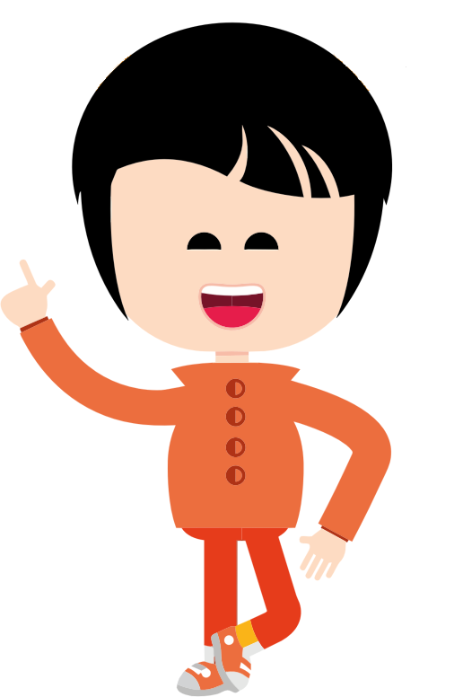

Notes:
This is London. London’s friend Carter has a broken arm. London is going to visit Carter at her/his house. London’s friend says that if London goes to play with Carter at his/her house s/he could have a broken arm just from visiting with Carter who has a broken arm.

Slide 2
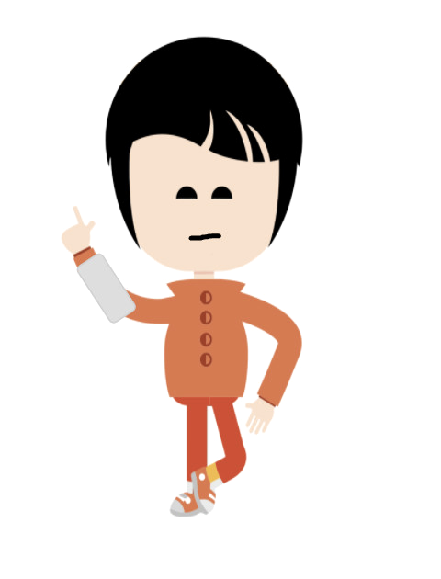
Notes:
Can that happen? Can London get a broken arm just from playing with Carter while s/he has a broken arm? Or can that not happen. Can London not get a broken arm just from playing with Carter while s/he has a broken arm?

Slide 3

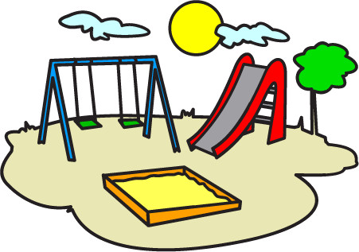
Notes:
This is Gray. Gray is at the playground.

Slide 4


Notes:
Gray is throwing a ball. Gray is throwing the ball near a lake. Gray’ friend tells Gray that if he throws the ball into the water it will make a big splash.

Slide 5

Notes:
Can that happen? Can Gray make a splash just by throwing the ball into the water? Or can that not happen? Can Gray not make a splash just by throwing a ball into the water?

Slide 6
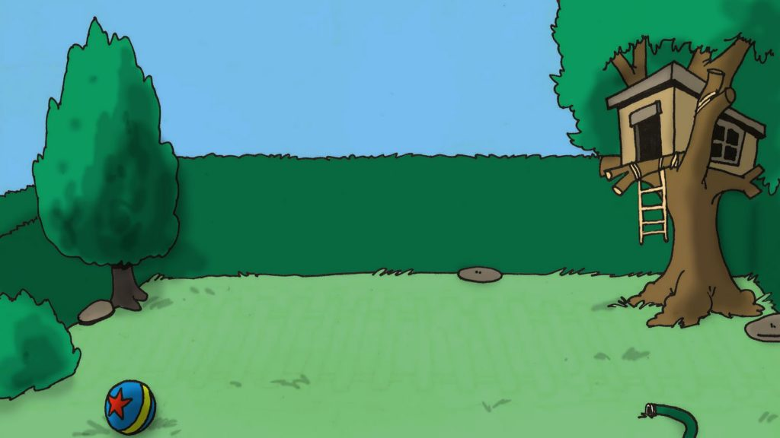

Notes:
This is Taylor. Taylor is in her/his backyard. Taylor is jumping rope. Taylor has been jumping rope for a long time. Taylor’s friend tells Taylor that if s/he keeps jumping rope s/he will get very tired.

Slide 7



Notes:
Can this happen? Can Taylor get tired just from jumping rope for a long time? Or can this not happen? Can Taylor not get tired just from jumping rope for a long time?

